Slide 1



API Management
Publish, manage, secure, and analyze your APIs in minutes
Raphael Bickel | Cloud Solution Architect | Microsoft
January 19th, 2019

Slide 2
Agenda
API Management, what does it solve ?
Features overview
Demo
Questions

Slide 3
Digital Transformation runs on APIs
Connected experiences
APIs
Services and data
Notes:
API helps Transformation and optimization
Enable new business models
Centric strategies
Innovative business models
New connected experiences
Are enabled by API
APIs are abstraction. Decoupled consumption from implementation
APIs are reusable. Long period of time, used by many customers
HTTP APIs. Extremely well adopted. Standards, Open APIs
Available on any platform by any programming language
Building and consuming an API is a solved problem
Flexibility
Can change the backend architecture, location, transport without impacting the API
Front door for authentication, metering
Evolve backend APIs
Enable
Enable developers to find APIs
Test APIs

Slide 4

API management solves API-related challenges
Discover
Learn
Get access
Try
SDKs and samples
Get help
Connected experiences
Abstract
Secure and protect
Manage lifecycle
Monitor and measure
Onboard developers
Monetize
Consume
Mediate
Publish
Developer portal
Gateway
Azure portal
APIs
Developers
(use APIs)
Publishers
(provide APIs)
Services and data
Notes:
How API management solves API related problems
Gateway is a mediation layer

Slide 5
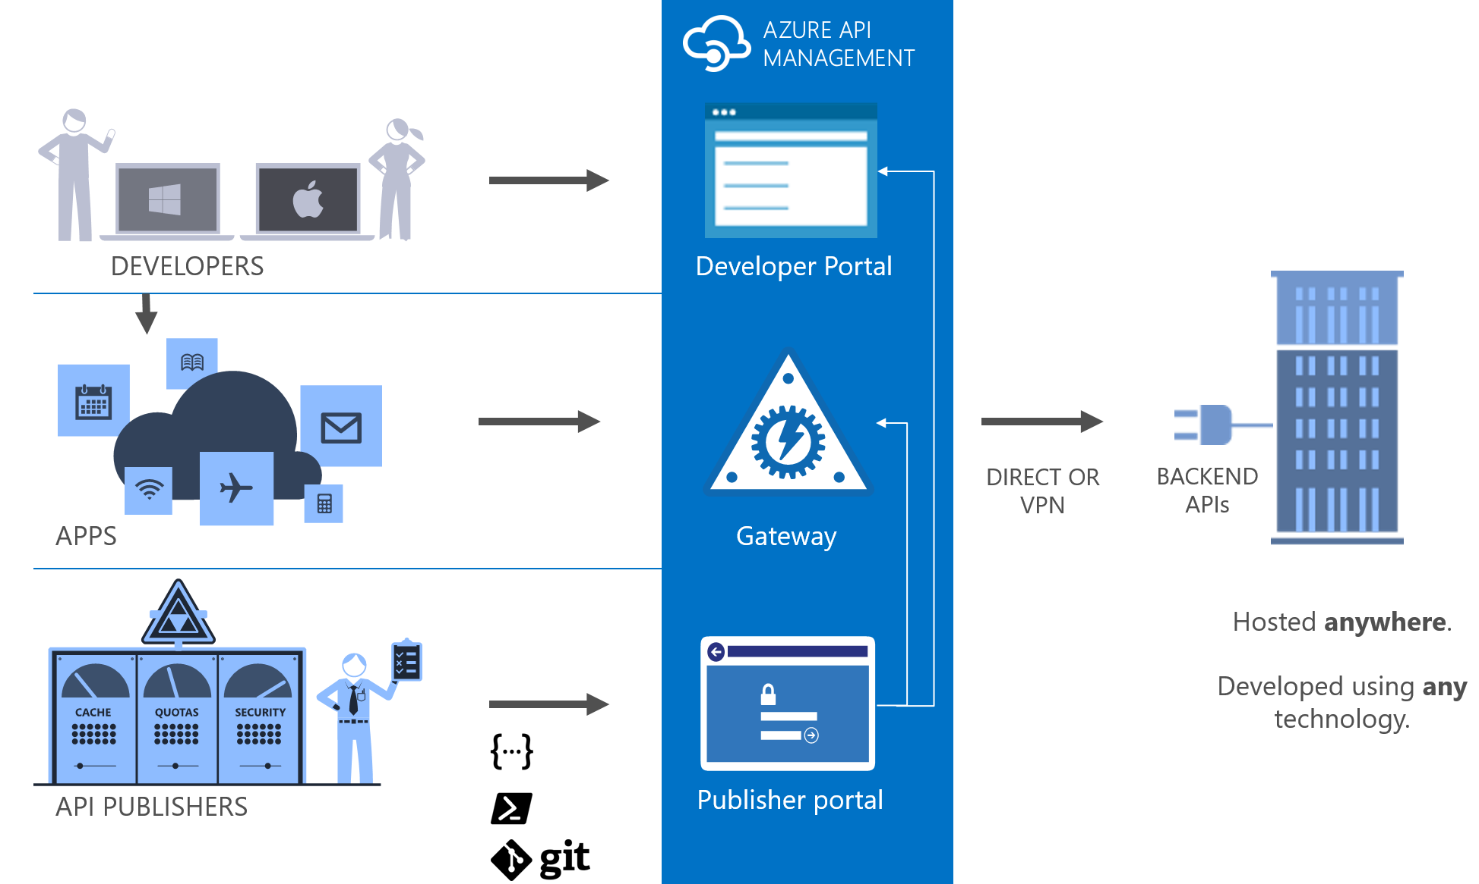
Protocols and integration
API specifications
Import
Create
Open standards
Backend
Hosted anywhere
Vnet integration
Multiple backend
Backend authentication
HTTP Basic
Client Certificate
Keys / Custom

Slide 6
Policies
Encapsulate common API management functions
Access control, Protection, Transformation, Caching, …
Chained together in a pipeline
Mutate request or context or change API behavior
Set for inbound and outbound directions
Can be triggered on error
Applied at a variety of scope

Slide 7






Security
Authentication
Username/password
Azure AD
Azure AD B2C
Facebook, Google, Twitter
Open Auth 2.0
Open ID Connect
Authorization
Product / Subscription based
Jwt token validation
Claim
Audience
Issuer

Slide 8
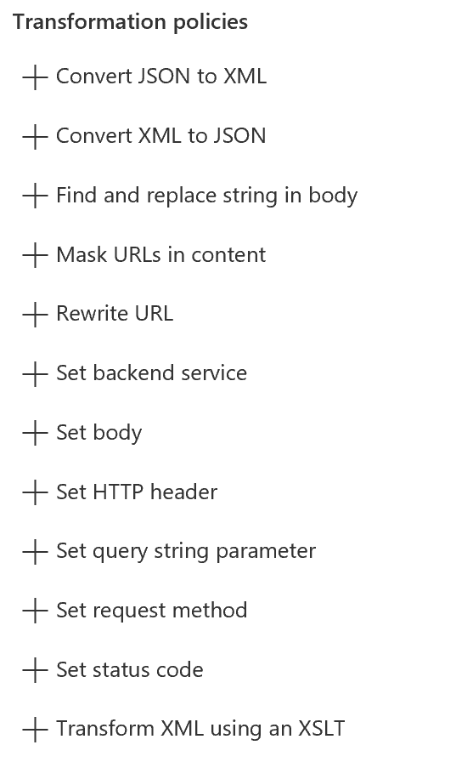
Content transformation
Content type conversion
XML to JSON
JSON to XML
XSLT transformation
Find/Replace
Mask URLs in content
Mocking
Custom processing with C#

Slide 9

Performance and scalability
Throttling
Caching / Redis
Horizontal scaling
Cross region

Slide 10


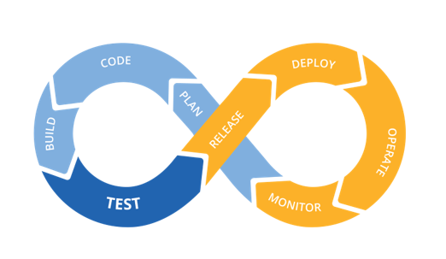






DevOps with API Management
ARM Templates
API Management
App Insights
Azure Monitor

Slide 11
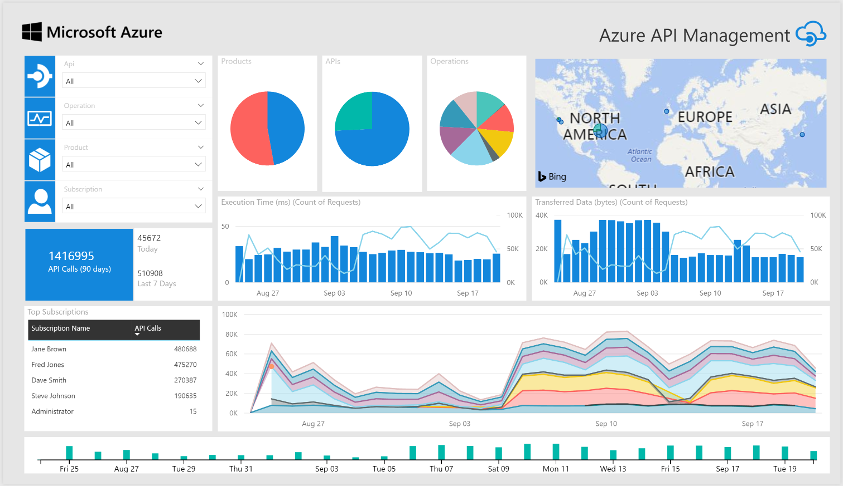
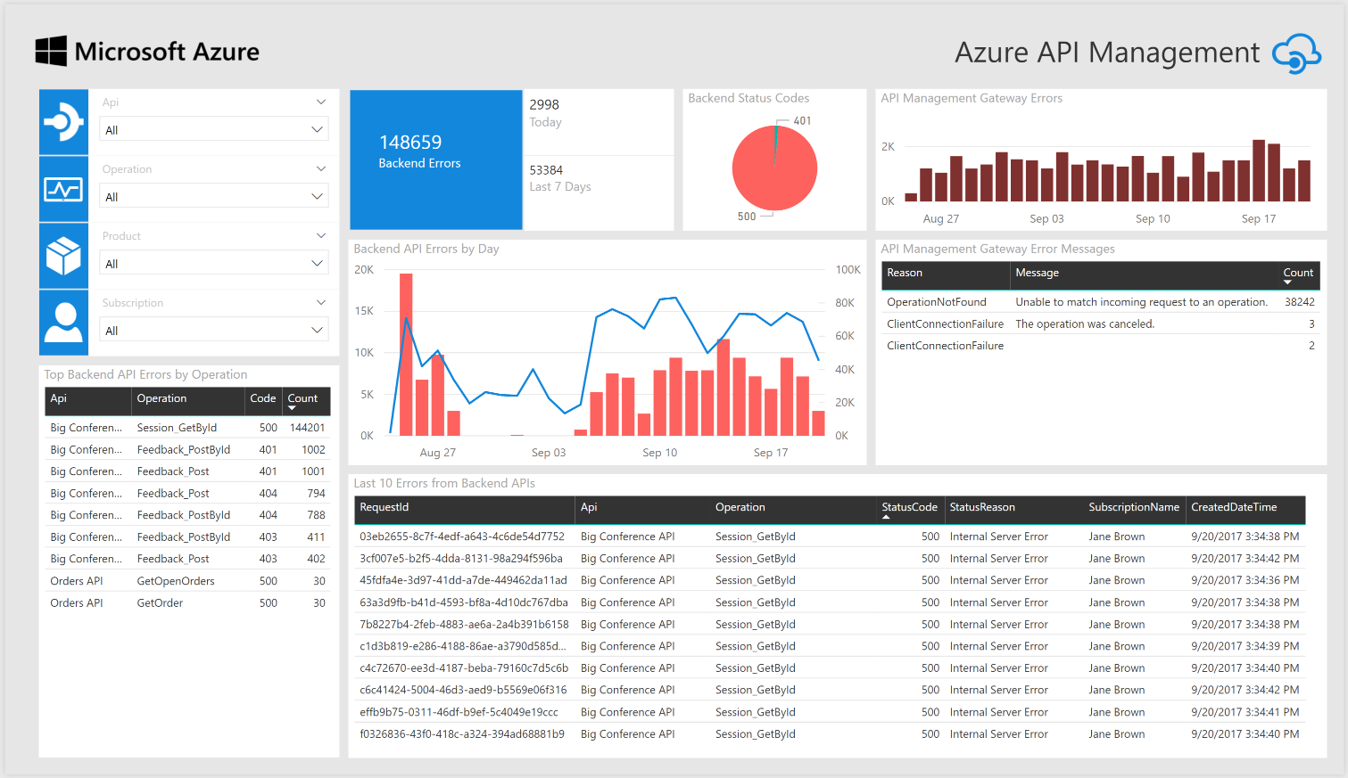
Monitoring and troubleshooting
API Inspector
Built-in reports
Power BI
Azure Monitor metrics
Event Hub
Application Insight

Slide 12
Demo
Raphael Bickel
Notes:
Import CalcAPI (http://calcapi.cloudapp.net/calcapi.json)
- Present flow and policies
- Present Developer portal
Present Revisions and versioning
Add Policy Set Request Header: accept:application/json
<xml-to-json kind="direct" apply="always" consider-accept-header="true" />
<set-header name="accept" exists-action="override">
<value>application/json</value>
</set-header>
Setup OpenIdConnect authentication
Setup provider
Show authentication from portal
Setup Authorization
Enable rate-limit
Bind an azure function to add operation “Power”
Create Function App (named Power)
Add Name table :
Function_url (rabickel-aritmetic.azurewebsites.net/api)
Function_key (api key)
Create new API operation with following policies:
<set-backend-service base-url="https://{{Function_url}}" />
<set-query-parameter name="code" exists-action="override">
<value>{{Function_key}}</value>
</set-query-parameter>

Slide 13
Questions
Resources:
aka.ms/TDCAPIM
Raphael Bickel ¦ Cloud Solution Architect ¦ Microsoft Geneva
Phone: +41 (78) 844 6033 ¦ Email: raphael.bickel@microsoft.com
Microsoft, 2-4 route de Peney, CH-1214 Vernier

